Slide 1
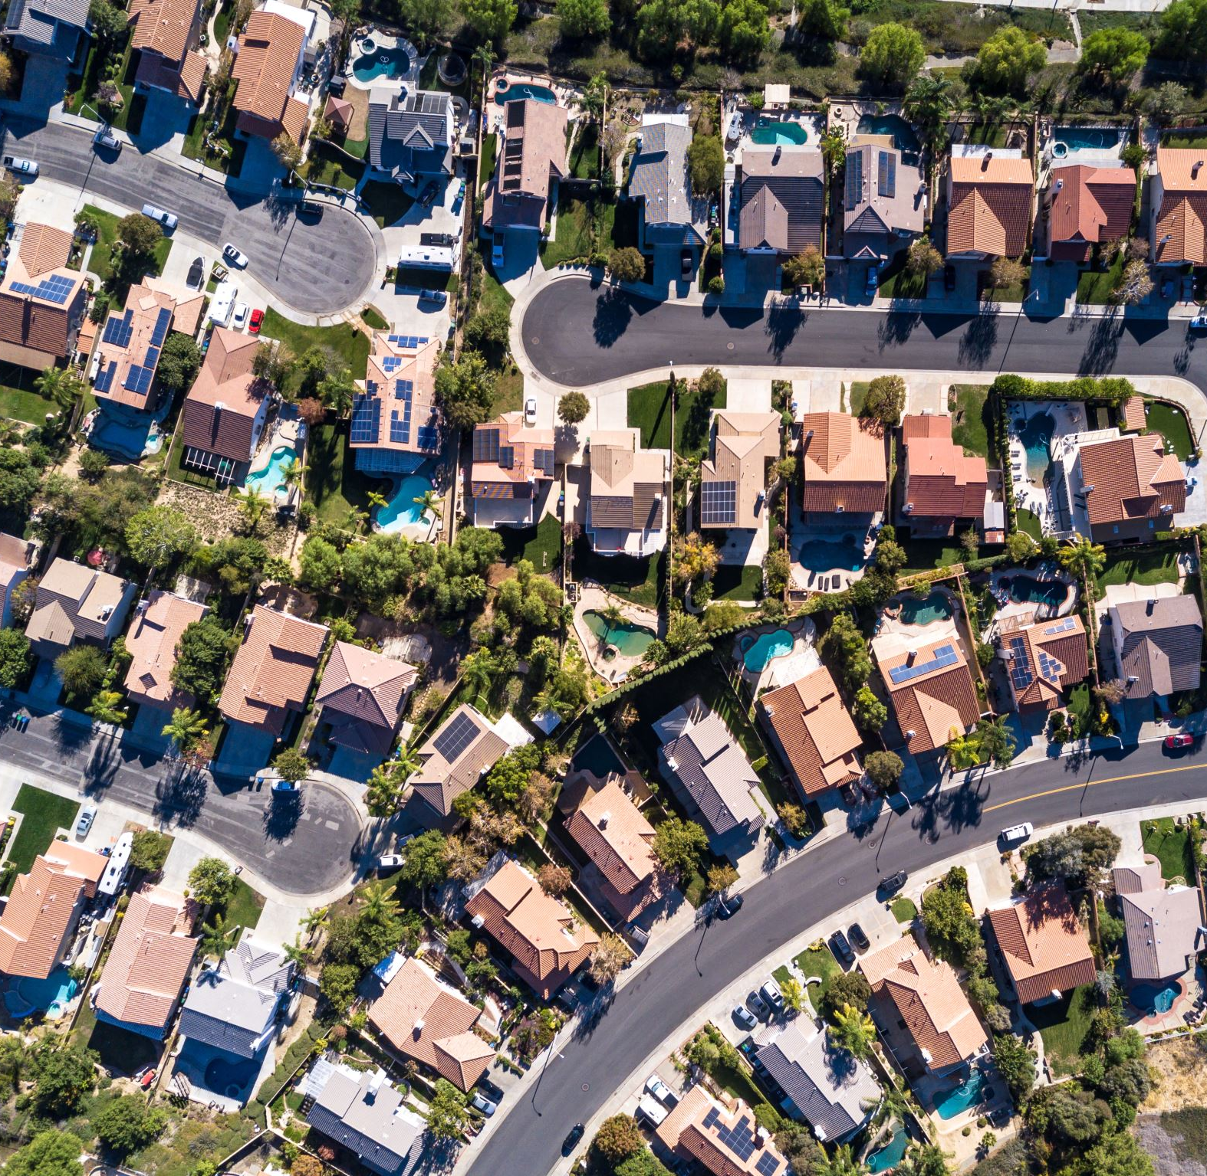
Analysis of San Francisco Housing Market
Methods and tools to act against displacement and gentrification

Slide 2
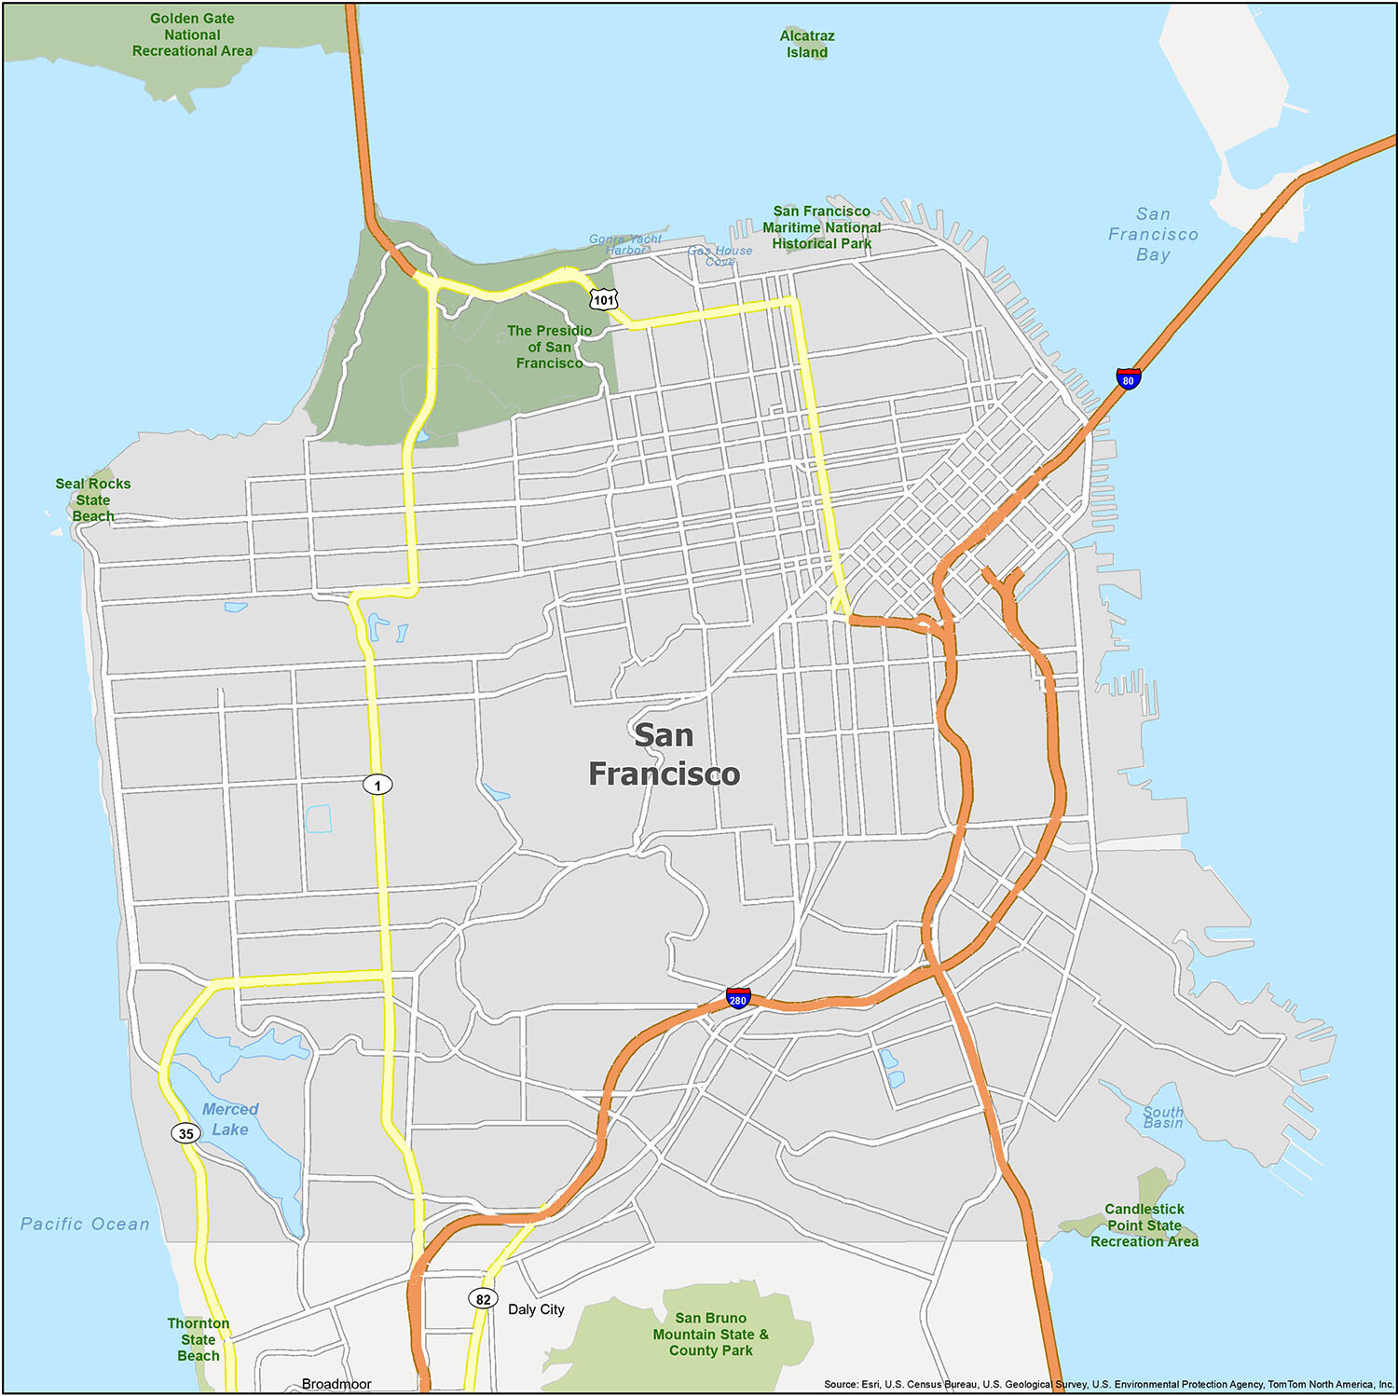
Reasons
Gentrification and displacement
With gentrification we refer to the process whereby the character of a poor urban area is changed by wealthier people moving in, improving housing, and attracting new businesses, often displacing current inhabitants in the process.
Use statistical methods and develope models to understand how the SF housing market has changed in the recent 15 years and which factors drived those changes.
Provide to the local government tools to tackle the problem of gentrification and displacement.
Further validate previous papers on the topic.
Goals

Slide 3
Goals
Use statistical methods and develope models to understand how the SF housing market has changed in the recent 15 years and which factors drived those changes.
Provide to the local government tools to tackle the problem of gentrification and displacement.
Further validate previous papers on the topic.

Slide 4




Rent
Buyout
&
Evictions
Constructions
Parcels
Evictions&Buyout
Address
Date (of emission)
Existing and proposed use
Existing and proposed housing units
Latitude and longitude of the vertices of the parcel
# houses for each parcel
Year of construction
Neighborhood
Price/mq
Date of the advertisement
# Beds, baths and rooms
Address
Neighborhood
Date
Motivation of the eviction
Buyout amount

Slide 5
Buyout
&
Evictions
Rent
Dataset
Parcels
Constructions

Slide 6
Datasets
Rent
Neighborhood
Price/mq
Date of the advertisement
Number of beds, baths and rooms
Mappa rent medi

Slide 7

Datasets
Evictions&
Buyout
Address
Neighborhood
Date
Motivation of the eviction
Buyout amount
Mappa con media buyout amout?
Mappa con numero evictions nel periodo

Slide 8
Datasets
Construction
Address
Date (of emission)
Existing and proposed use
Existing and proposed housing units

Slide 9

Datasets
Parcel
Latitude and longitude of the vertices of the parcel
Number of houses for each parcel
Year of construction

Slide 10
Exploratory analysis

Slide 11
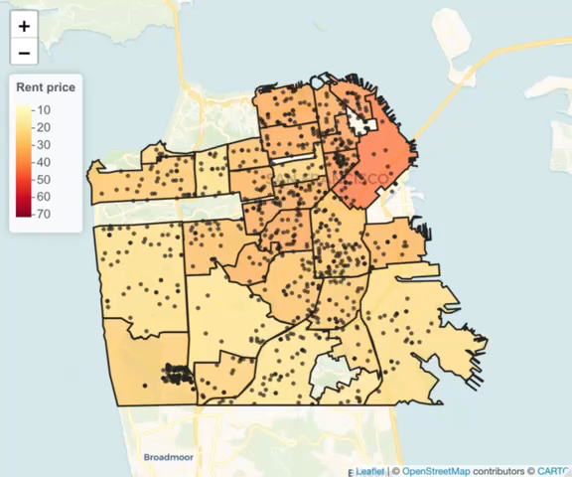
Map of
Prices evolution

Slide 12
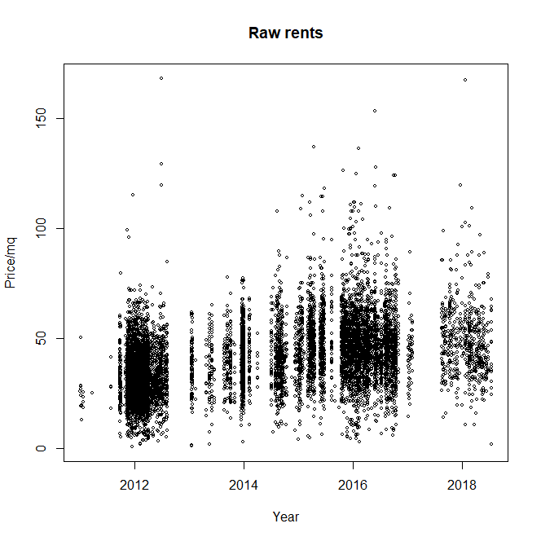
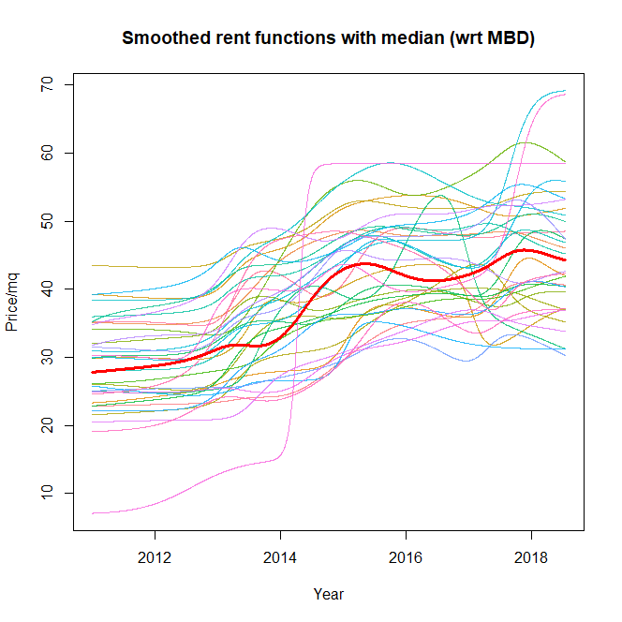
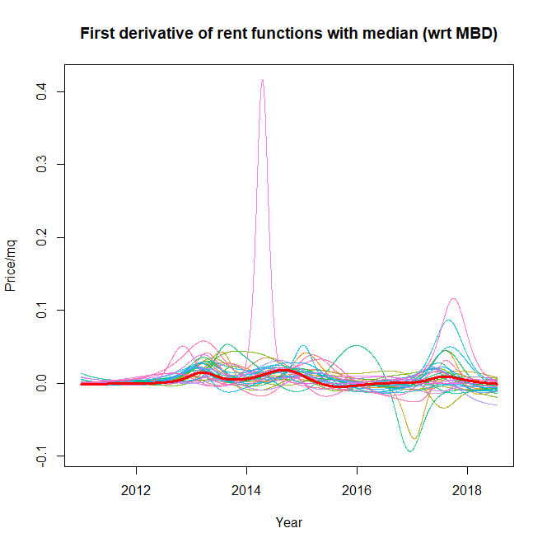
Smooth rent functions
Io credo sia meglio tagliare sull asse y così da vedere bene le derivate vicino 0

Slide 13
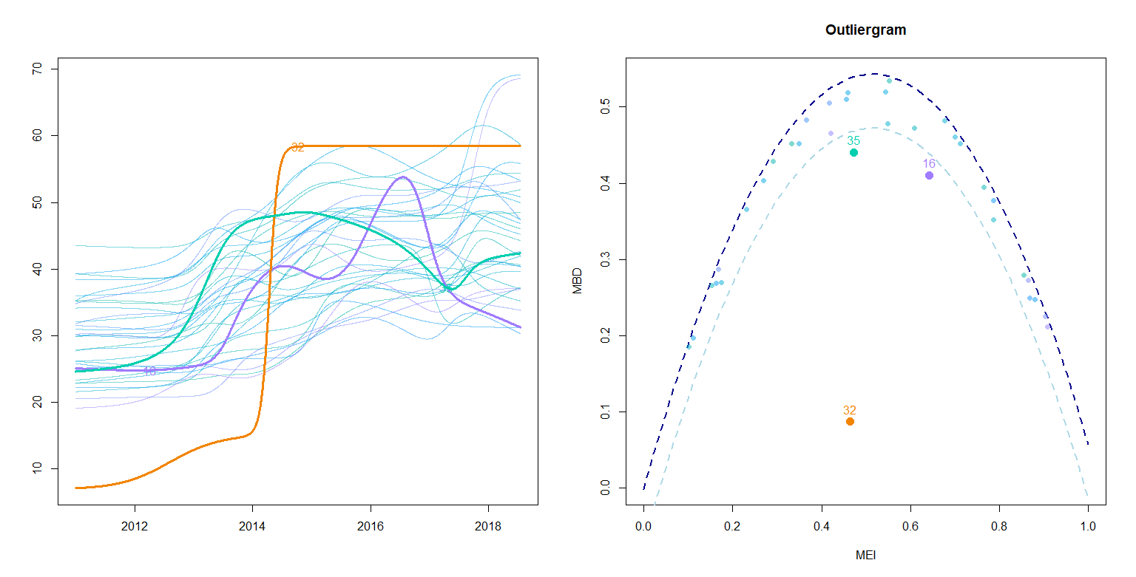
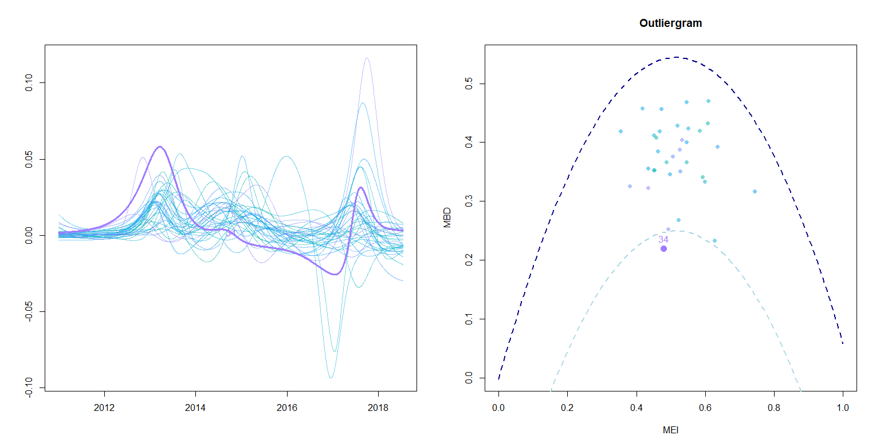
Outlier Detection
32 : treasure island
È utile? Cosa diciamo?
34: Western Addition

Slide 14
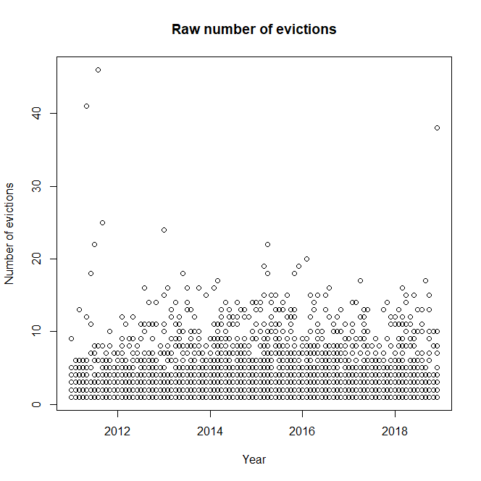
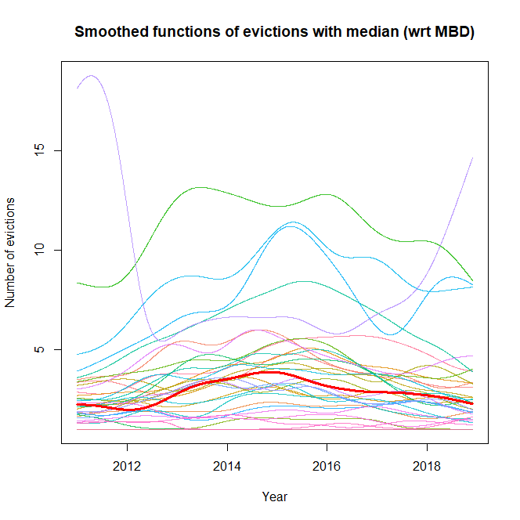
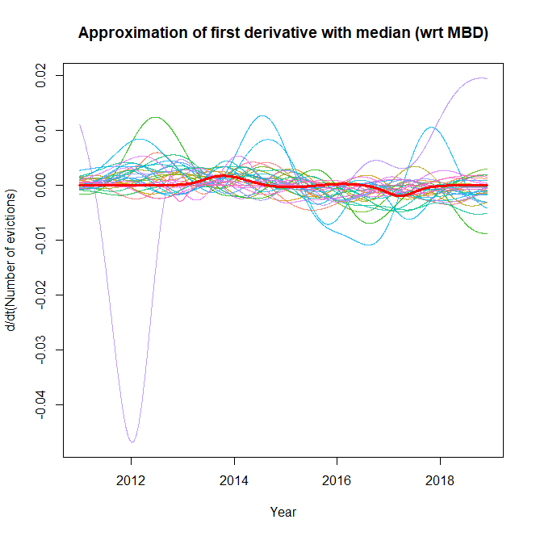
Smooth evictions
Idem a rent smoothing

Slide 15
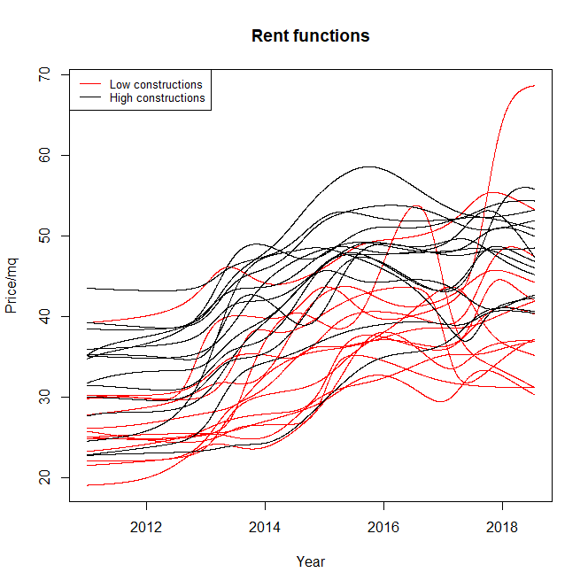
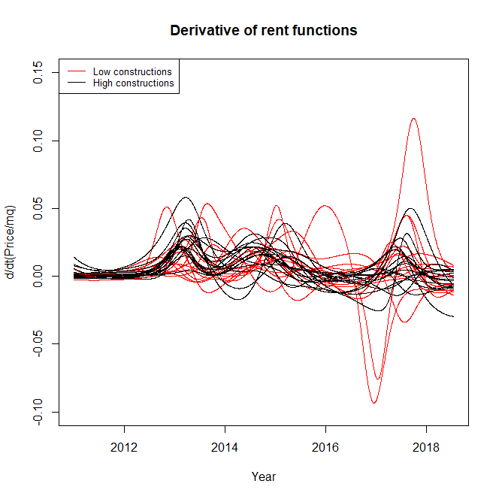
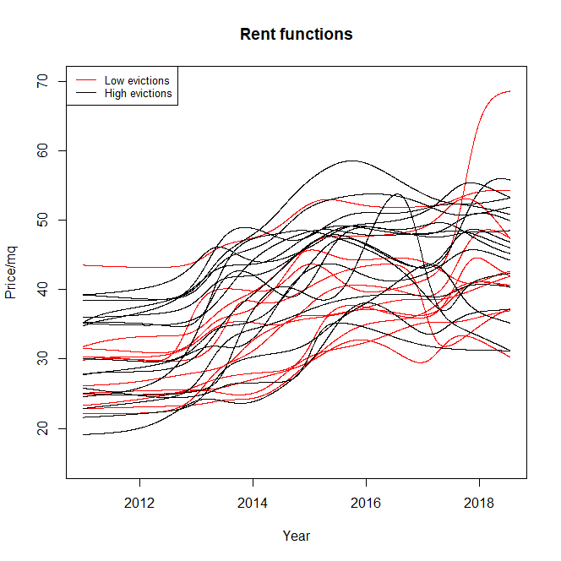
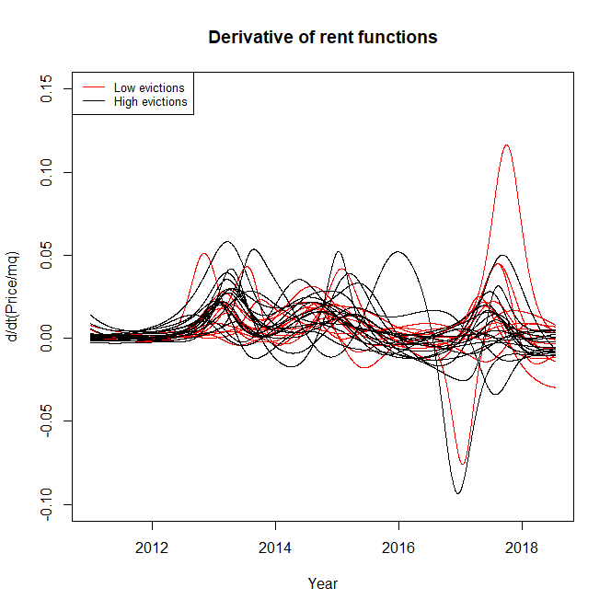
Test on
Rent functions
Metterei i plot dove si vedono i p-value

Slide 16
Constructions effect on rent

Slide 17
GAM model

Slide 18
Future analysis

Slide 19
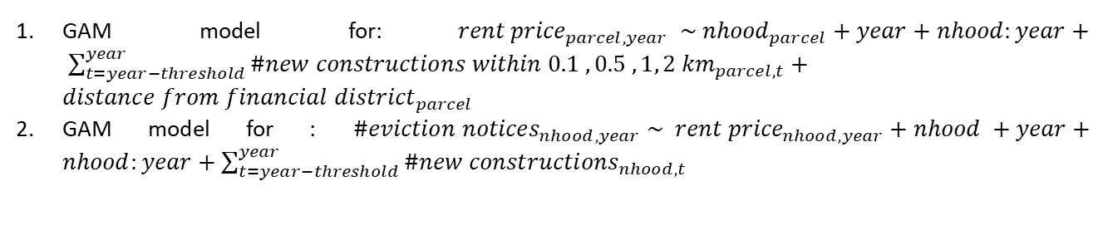
Extension of the GAM model
Smoothing of the rent prices over the area of SF
Create a GAM model for the rent prices with a spacial dependence on the number of new construction, Google bus stops
GAM model for:${rent price}_{parcel, year} \sim {nhood}_{parcel}+year+nhood:year+ \sum_{t=year−threshold}^{year}{{\#new constructions within 0.1 , 0.5 ,1, 2 km}_{parcel,t}}+{distance from financial district}_{parcel}$
GAM model for : ${\#eviction notices}_{nhood,year} \sim {rent price}_{nhood,year}+nhood +year+nhood:year+\sum_{t=year−threshold}^{year}{{\#new constructions}_{nhood,t}}$

